Slide 1
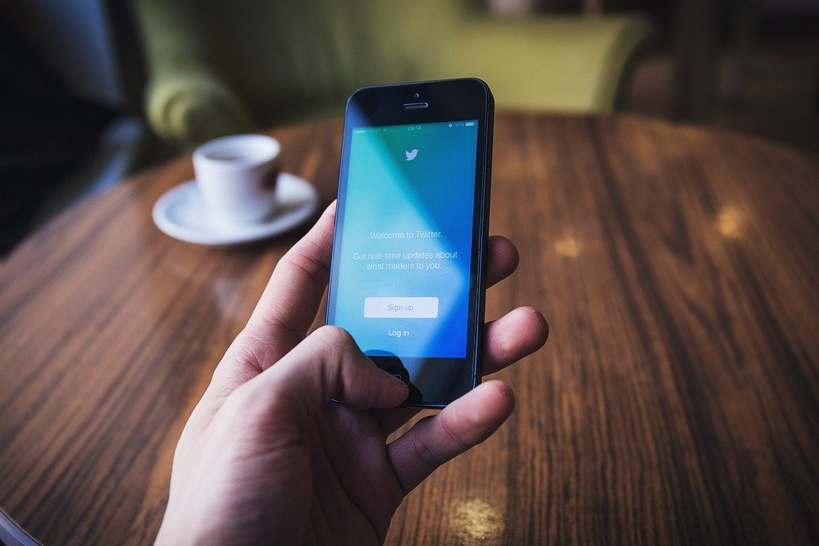
Amazon phone deals
Group 2:
Kunal Joshi
Muriel Banze
Priyanka Mannikeri

Slide 2
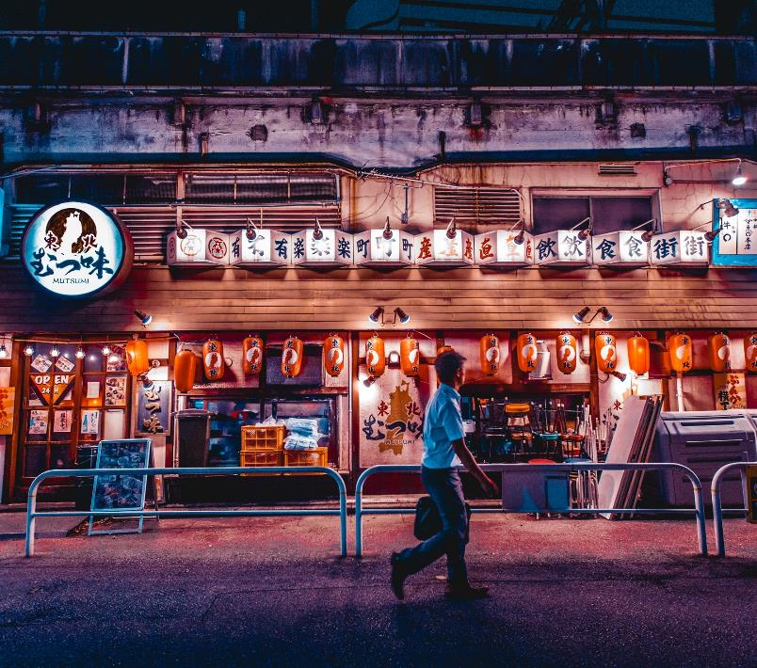
Table of Contents
Introduction
System requirements
System functionality
Conclusion

Slide 3
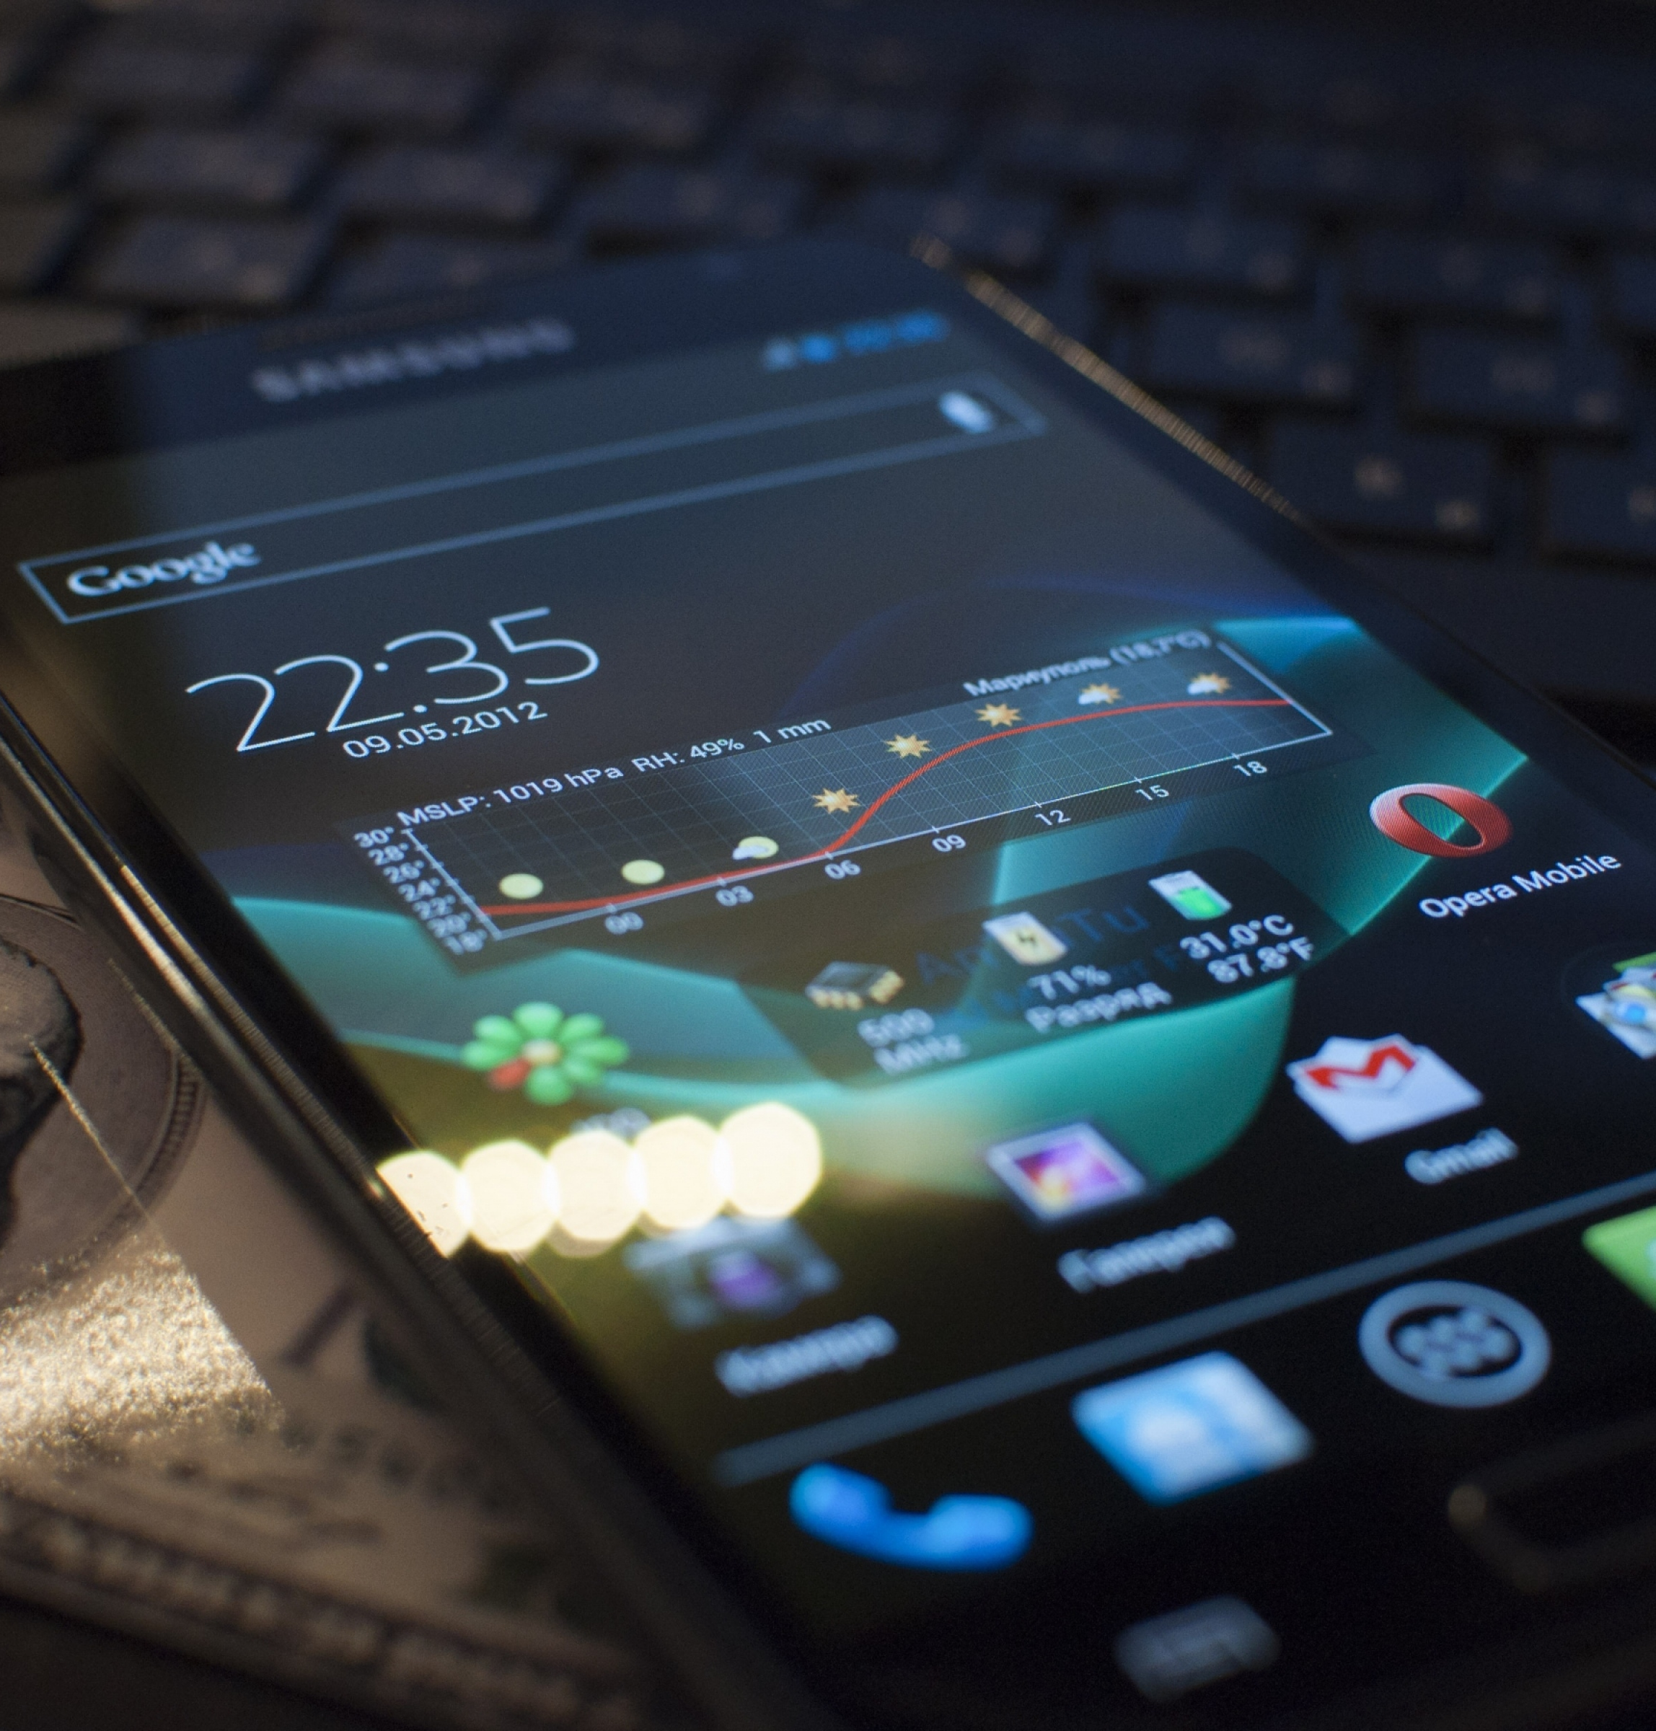
Introduction
The cellphone is the most widely used form of communication and forms an integral part of people’s daily life.
They aid people to stay in a constant contact with their family, friends and in keeping abreast in their daily business transactions throughout the world.
However, when it comes to buying a cellphone at times people end up buying a phone which might not provide good service after a period of time of constant usage.
This is mainly due to poor research and inadequate means of information that would have enabled the user in choosing the right device.
The main motivation for this project is to provide the user with enough information about a device and so that they can make the right choices before investing a huge sum of money.

Slide 4
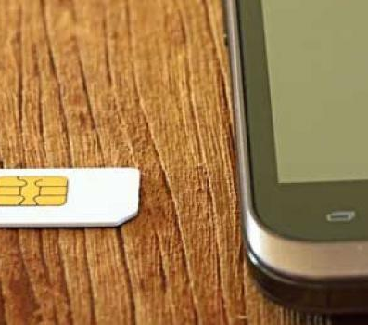
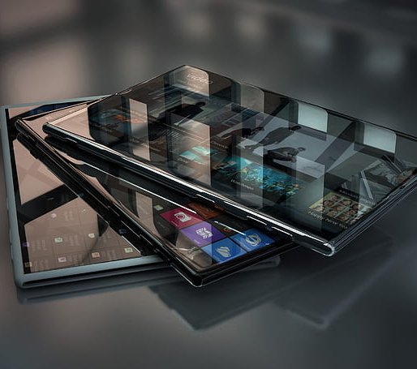
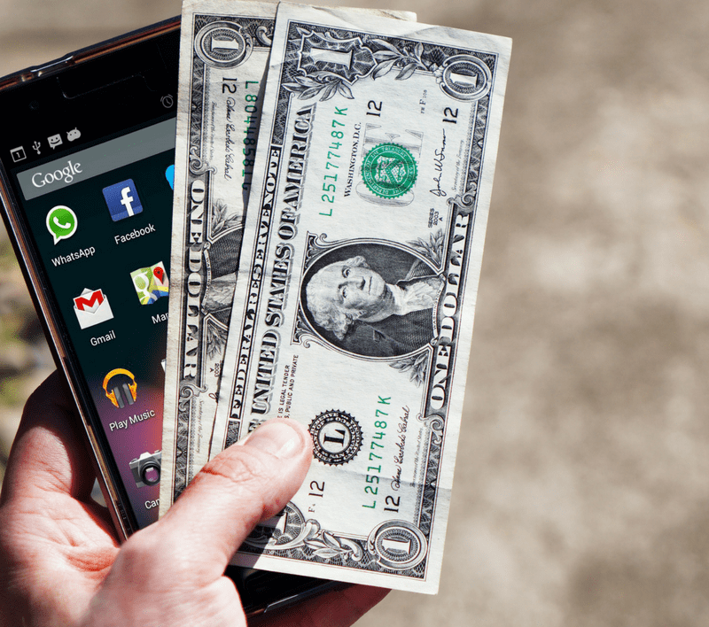
Introduction continued…
Several factors should be taken into account while buying a cellphone
What's your budget?
Do you have an existing cell phone plan, and if so, do you have a free upgrade?
Are you looking to switch carriers, or to sign your first service contract?
How is your credit?
Are you willing to sign a service contract at all?

Slide 5
System Requirements
Dataset description:
The dataset was taken from Kaggle, Amazon cell phone reviews.
This dataset consists of 14 columns each providing details about a specific cell phone brand.
This dataset has around 9500 records.
It contains information such as the brand name, its reviews, price details and features as well.
The image and the product URL’s are also mentioned.
It also contains geo locations such as the latitude and longitude of the reviewer.
Technology used:
Cloud service – MongoDB Atlas
The dataset was loaded by using the MongoDB GUI called MongoDB Compass Community.
User Interface – Developed by using a python toolkit called PyQt.

Slide 6
System Functionality
Data Pre-Processing:
The dataset consisted of Image URL’s which has to be stored in a separate database. In order to do so its content has to be stored in the form of chunks. These chunks together form the images.
A python script was developed to convert this image URL to chunks consisting of image data.
A separate database named amazonImages was created, to fetch product images from GUI screen.
Issues regarding this dataset before implementing it with the GUI.
About 4000 values from Product_name column found to be null. As Product_name column is important for this application, so we handled null values in this column by skipping those using condition in our program.
This dataset has 2931 images. While uploading images to amazonImages database, due to null values in Product_img column, all images were not getting uploaded. So, we handled null values in our python code.
While uploading images to amazonImages database, getting time out error. So, we added timeout function in our python program to avoid this error.

Slide 7
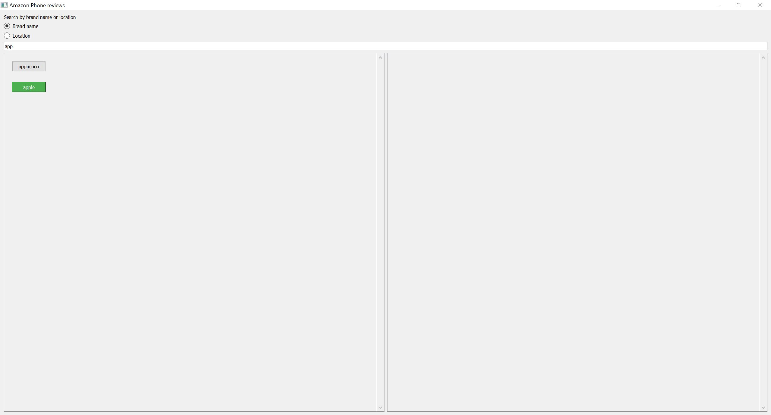
GUI Functionalities
Partial word search
When a user enters only part of the query word, the GUI manages to find whole word.
Adjacent GUI snippet demonstrates the example of partial word search functionality in our program.

Slide 8
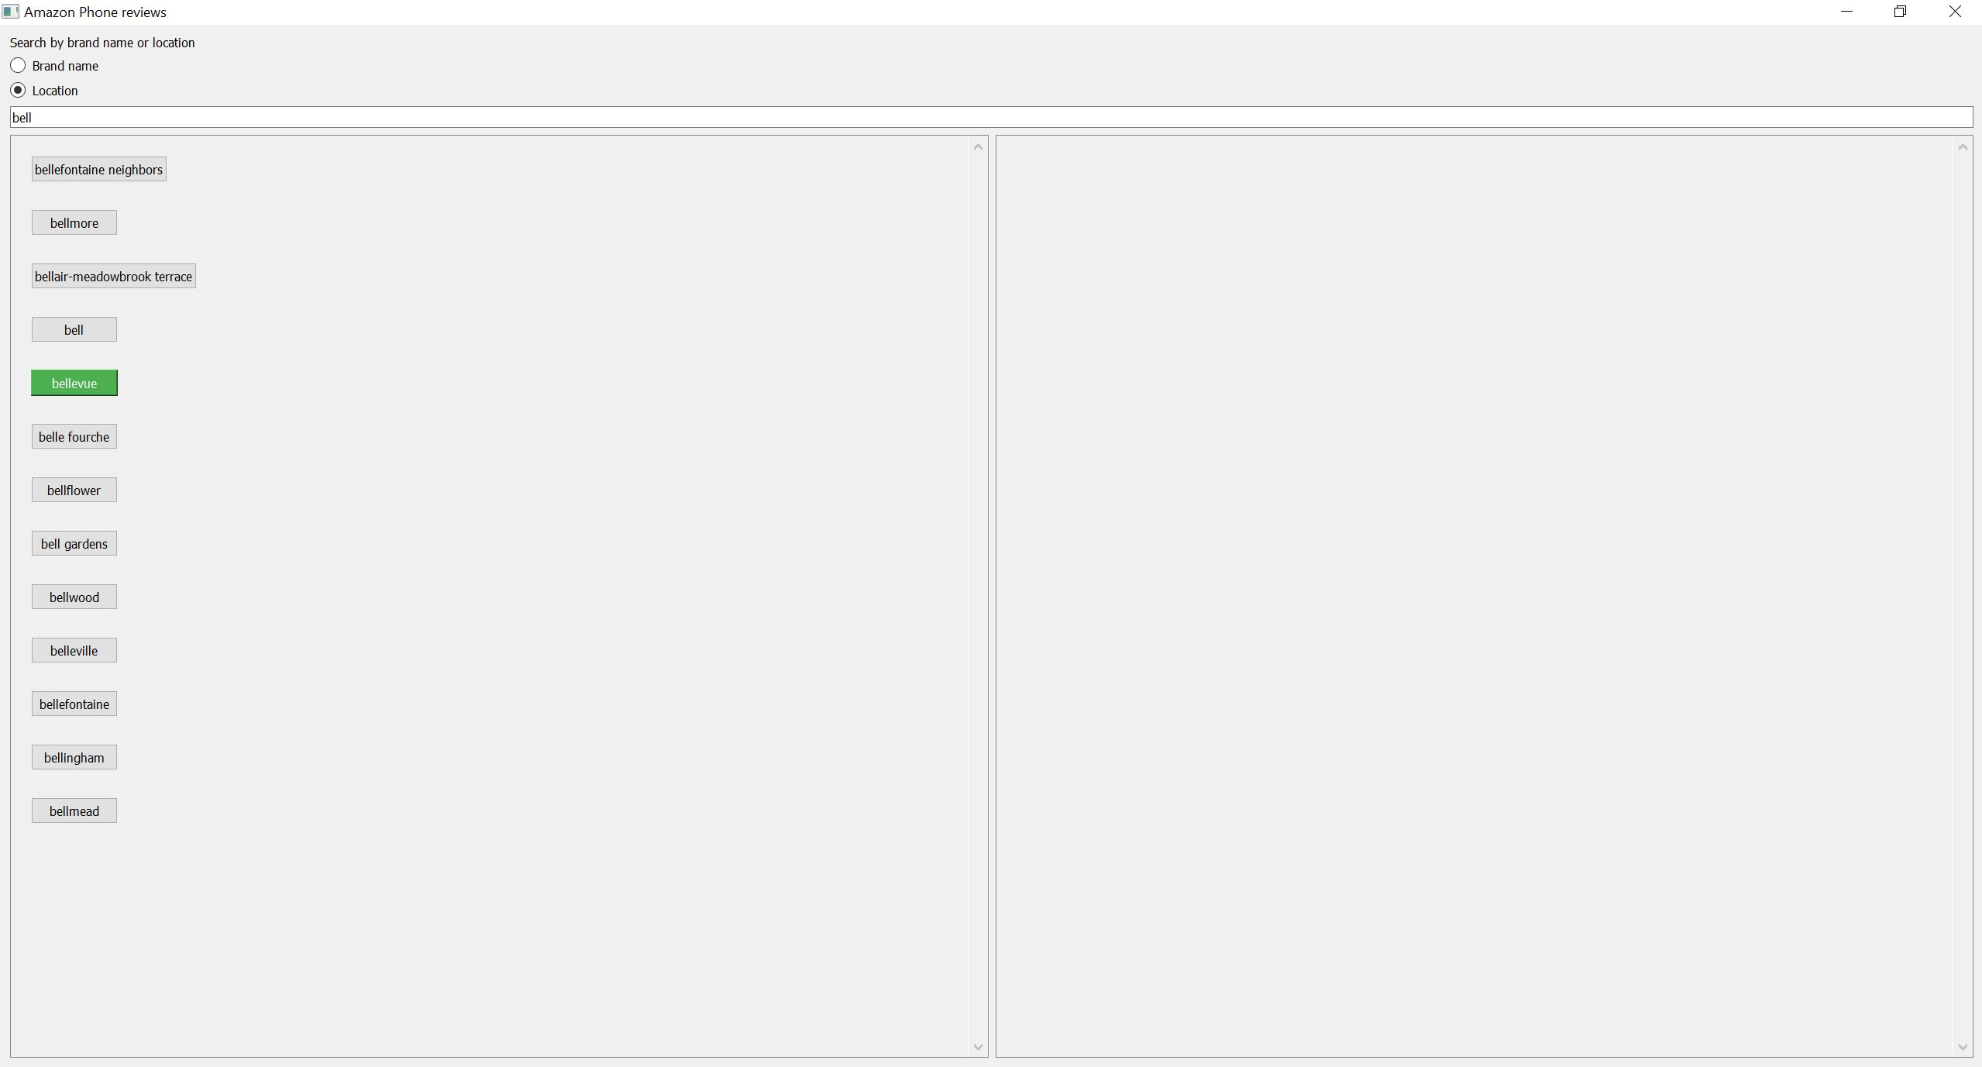
GUI Functionalities continued…
Geo search
The user can search product by using Geo location values in the database.
Adjacent GUI snippet demonstrates the example of GUI search functionality in our program.

Slide 9
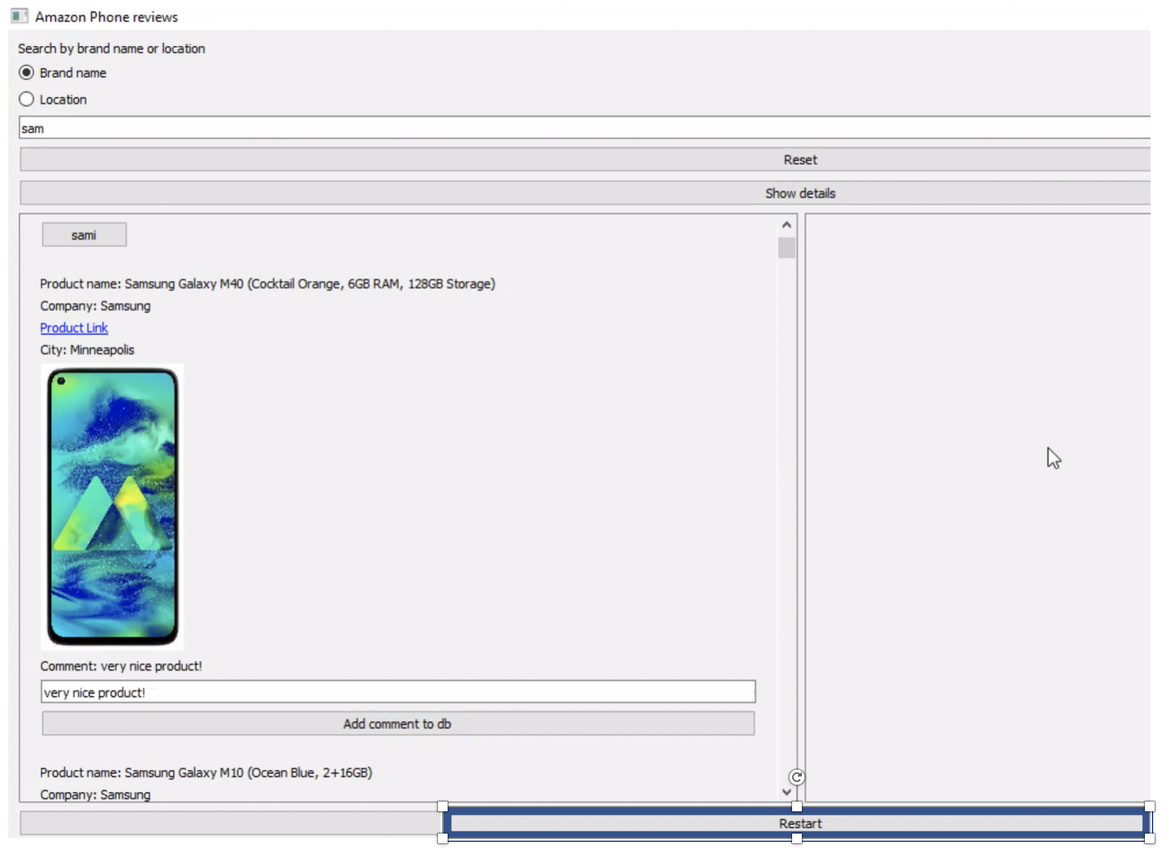
GUI Functionalities continued…
App gets closed
The app gets closed when user want to quit by clicking on “Restart”. He can also add the comments to the product. If he wants more details , he can click on “Product Link”
Adjacent GUI snippet demonstrates the example of GUI app close functionality in our program.

Slide 10
Conclusion
By using this application, user can get better information about various kinds of phones available in the market.
Search according to geo locations gives better insight to customers for availability of phones in their nearby locations.
Users can search for customer reviews before making any decision for any kind of phones and also can add their on reviews.

Slide 11

THANK YOU!
+1 23 987 6554
april@www.proseware.com

